Slide 1






Bootcamp
CV (Curriculum Vitae)
Basic Level
CAROLINA GOMEZ M.
MAY 29th, 2024

Slide 2
Table of content
1
Review
2
Curriculum
3
Vocabulary

Slide 3
What did we do last class?
Virtual Calls
Phone Vocabulary
Online Meetings
https://wordwall.net/es/resource/54146885/online-meetings-test

Slide 4


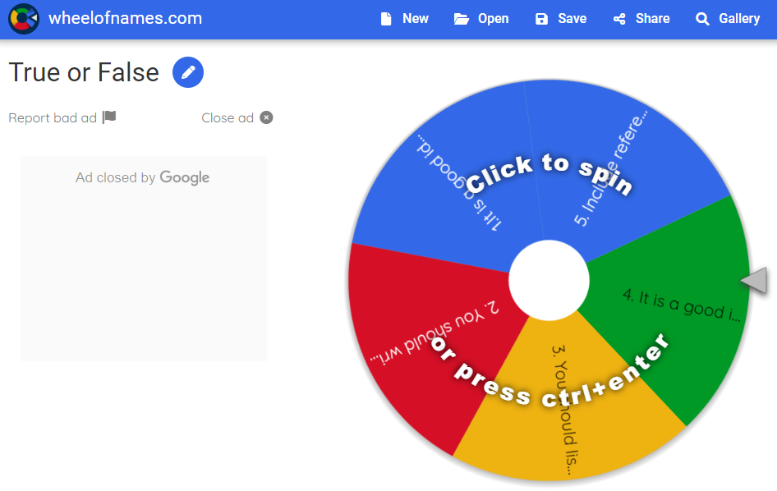
Warm Up
https://wheelofnames.com/8k7-h6p

Slide 5
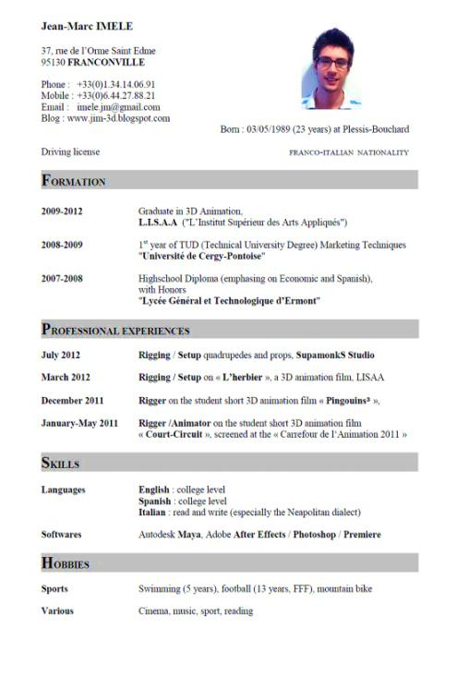
Reading Activity: CURRICULUM VITAE
CURRICULUM VITAES: TIPS THAT HELP
Six out of ten CV’s which are prepared by Information Technology professionals fail to meet the basic standards and are turned down without even being read fully, according to a recruitment company. As a consequence, thousands of candidates are excluding themselves from attractive job opportunities.
Although the company handles over 60,000 CV’s per year, it estimates that at least 60% would not be admitted if they were sent directly to potential clients due to basic errors.
The company Marketing Director said, “Sadlyit’s often the most highly qualified candidates whose CV’s are so poorly constructed that they are literally dead on arrival. Attractive job opportunities in the IT industry often generate intense competition and there is often little to choose between the candidates”.

Slide 6
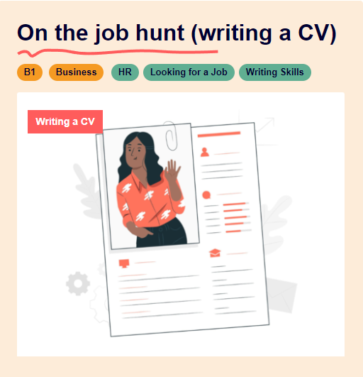
CURRICULUM VITAE
“Advice on the presentation format of CV’s in relation to the requirements that they are being submitted for should be an Industry standard so as to add real value to the candidates that you are representing and indeed to fulfill your professional obligations to your clients”. “Writing a CV can be extremely difficult and too often a CV turns out to be a generic overview including a lot of information that is irrelevant. People should remember that an employer typically spends between 15 and 30 seconds scanning each CV and you have that one chance to make an impression”.
“A good CV is more than just documentation of your career path; it is a marketing tool designed to present your professional career experience according to the new job specification. It should also include details of past professional successes that effectively demonstrate your ability to undertake the job responsibilities outlined”.
.

Slide 7

Reading Comprehension Exercise
For questions 1-6 choose the correct option a), b) or c)
1. Six out ten CV’s are …
a) attractive.
b) badly written.
c) well-done.
2. Recruitment companies say that potential clients …
a) make basic mistakes.
b) only get 60% of CV’s.
c) reject CV’s with mistakes.
3. The Marketing Director said that the best candidates …
a) are the most affected.
b) do not send CV’s.
c) write the best CV’s.
Notes:
Answers to the comprehension questions:
1. Bob's main concern regarding robots and automation is that they will take over jobs, leading to unemployment and potentially causing societal upheaval.
2. The speaker counters Bob's concerns by pointing out that technological advancements have historically led to increased efficiency and prosperity, and that humans have adapted to these changes by learning new skills.
3. The speaker uses the example of the Industrial Revolution to illustrate the impact of technological advancements on employment, highlighting how automation has led to fewer people working fewer hours to achieve greater prosperity.
4. Some benefits of automation mentioned in the text include increased efficiency, reduced workload, and the ability to perform tasks that are difficult, dirty, dangerous, or time-consuming.
5. The speaker suggests that humans adapt to technological advancements by learning new skills and finding new opportunities, ultimately benefiting from having their previous jobs done by machines.

Slide 8
Reading Comprehension Exercise
4. The Marketing Director suggests that candidates ought to pay attention to …
a) CV’s presentation.
b) other companies.
c) other competitors.
5. The Marketing Director says that very often CV’s include …
a) necessary details.
b) unimportant information.
c) very little information
6. Candidates should remember that employers …
a) are typical people.
b) are very busy people.
c) make an impression on people.
Notes:
Answers to the comprehension questions:
1. Bob's main concern regarding robots and automation is that they will take over jobs, leading to unemployment and potentially causing societal upheaval.
2. The speaker counters Bob's concerns by pointing out that technological advancements have historically led to increased efficiency and prosperity, and that humans have adapted to these changes by learning new skills.
3. The speaker uses the example of the Industrial Revolution to illustrate the impact of technological advancements on employment, highlighting how automation has led to fewer people working fewer hours to achieve greater prosperity.
4. Some benefits of automation mentioned in the text include increased efficiency, reduced workload, and the ability to perform tasks that are difficult, dirty, dangerous, or time-consuming.
5. The speaker suggests that humans adapt to technological advancements by learning new skills and finding new opportunities, ultimately benefiting from having their previous jobs done by machines.

Slide 9
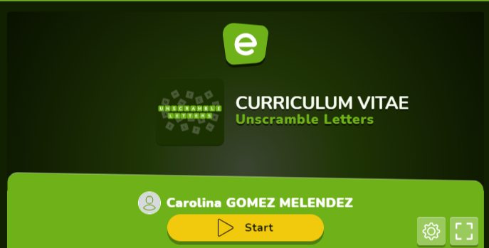
Let’s play with words
https://es.educaplay.com/recursos-educativos/19307043-curriculum_vitae.html
Notes:
Answers to the comprehension questions:
1. Bob's main concern regarding robots and automation is that they will take over jobs, leading to unemployment and potentially causing societal upheaval.
2. The speaker counters Bob's concerns by pointing out that technological advancements have historically led to increased efficiency and prosperity, and that humans have adapted to these changes by learning new skills.
3. The speaker uses the example of the Industrial Revolution to illustrate the impact of technological advancements on employment, highlighting how automation has led to fewer people working fewer hours to achieve greater prosperity.
4. Some benefits of automation mentioned in the text include increased efficiency, reduced workload, and the ability to perform tasks that are difficult, dirty, dangerous, or time-consuming.
5. The speaker suggests that humans adapt to technological advancements by learning new skills and finding new opportunities, ultimately benefiting from having their previous jobs done by machines.

Slide 10

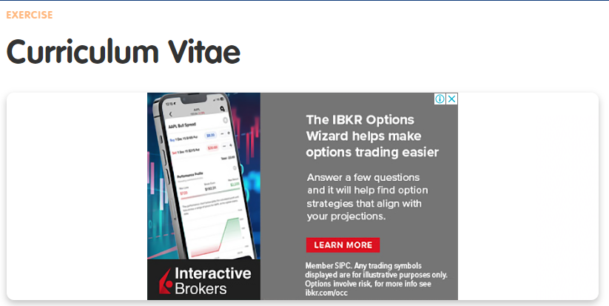
Vocabulary – Online Exercise
Choose the correct answer.
https://www.curso-ingles.com/en/practice/exercises/curriculum-vitae

Slide 11
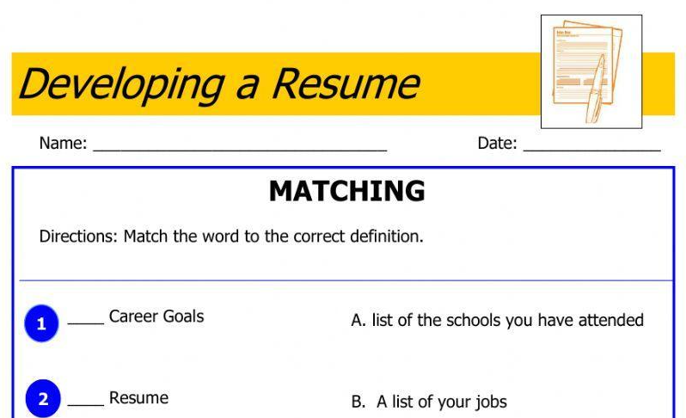
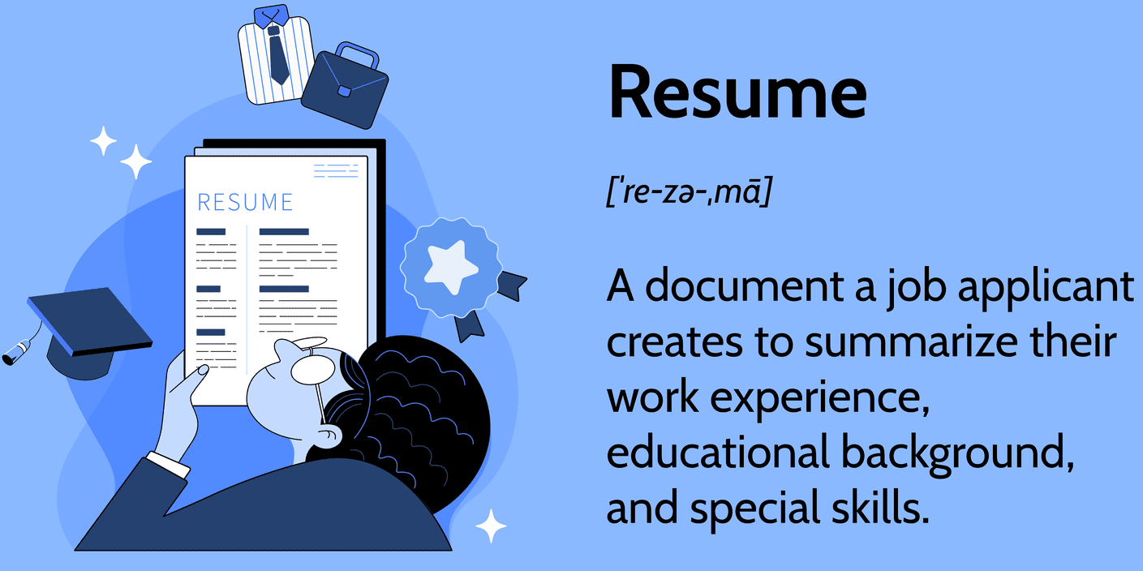
Practice # 1
What parts does a CV have?
https://www.liveworksheets.com/w/en/life-skills/777602
Notes:
Game: https://www.baamboozle.com/game/554532

Slide 12
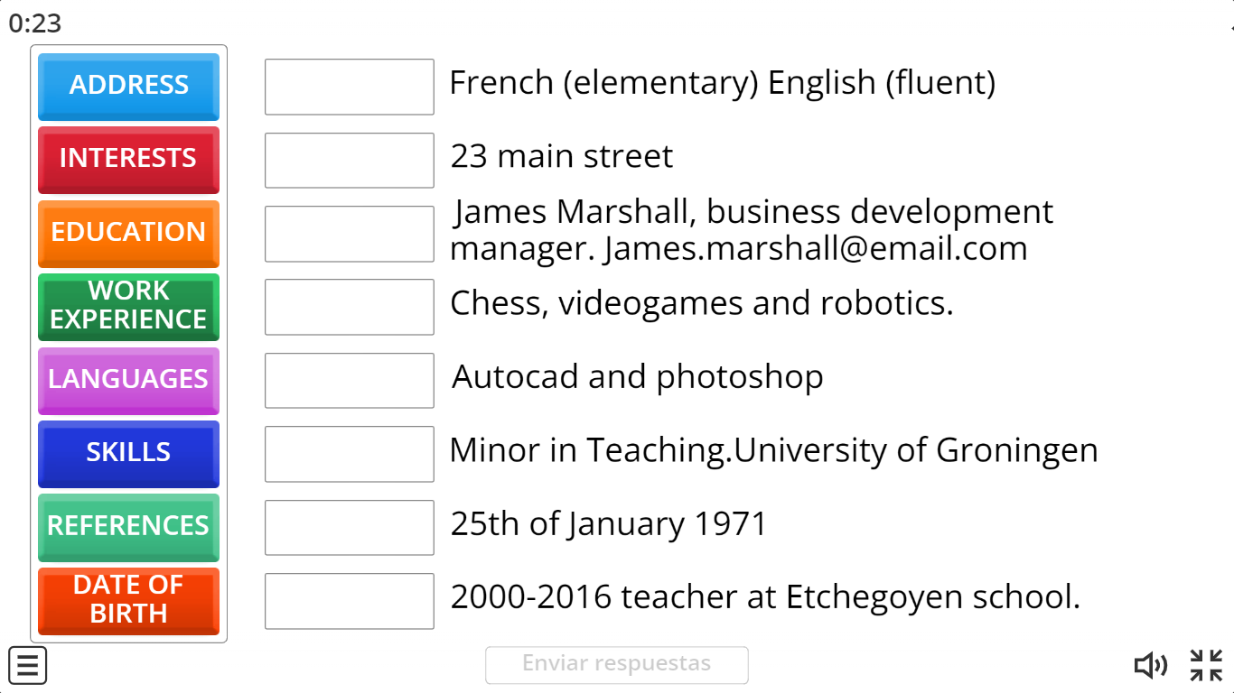

Practice # 2
Match the words related to Curriculum Vitae information.
https://wordwall.net/es/resource/57190789/curriculum-vitae
Notes:
Game: https://www.baamboozle.com/game/554532

Slide 13
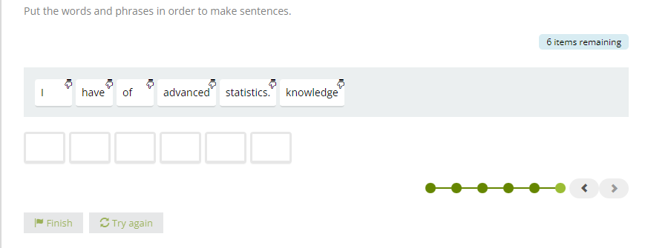

UNSCRAMBLE
Solve the Task 2.
https://learnenglish.britishcouncil.org/skills/writing/b2-writing/cv
Notes:
Video: https://www.youtube.com/watch?v=CP-wWXjQ4Oo&ab_channel=GuardianJobs

Slide 14


VIDEO ACTIVITY
Watch the video and answer the questions.
https://en.islcollective.com/english-esl-video-lessons/vocabulary-practice/general-vocabulary-practice/jobs-and-work/how-to-write-a-cv-the-most-essential-tips-to-follow/899193
Notes:
Video: https://www.youtube.com/watch?v=CP-wWXjQ4Oo&ab_channel=GuardianJobs

Slide 15
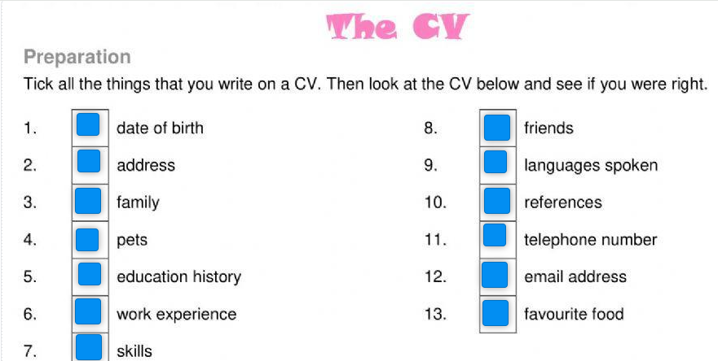
HOMEWORK # 6
Solve the exercises, take a print screen of the result, paste in a Word document and upload it in the drive.
https://www.liveworksheets.com/w/en/english-language/341814
Notes:
List: https://docs.google.com/document/d/133bPw_uU6quyaCW0KUGYRqIV5XJPFbGr/edit?usp=sharing&ouid=107132437745420382364&rtpof=true&sd=true

Slide 16


